Slide 1
Print PIMS label user manual 2015-2-5 MIS – ling.xie

Slide 2
Print PIMS label Solution workflow
Get
Enter Vendor for get data from MFG/Pro
Enter PI No for get Data from pi system[HK]
Scan
Scan Barcode
Print
Print Label

Slide 3
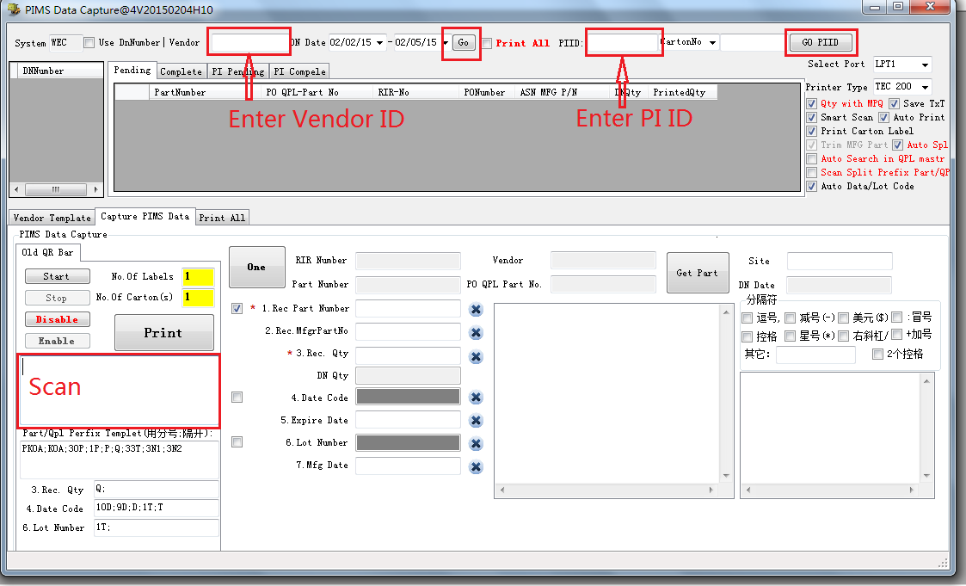
Print PIMS label Soft

Slide 4
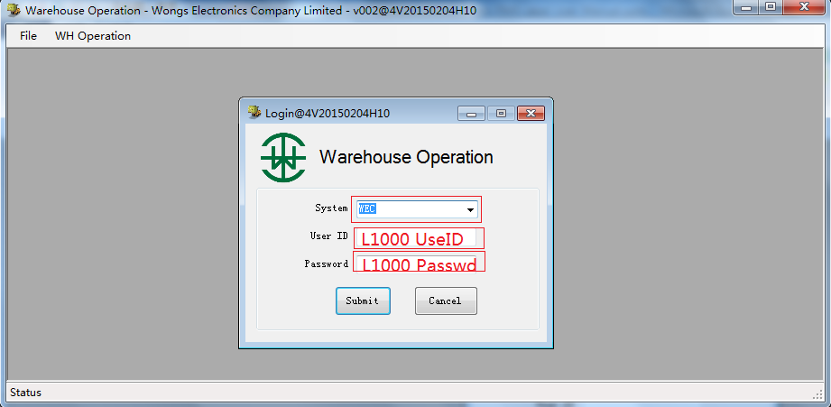
Log On

Slide 5
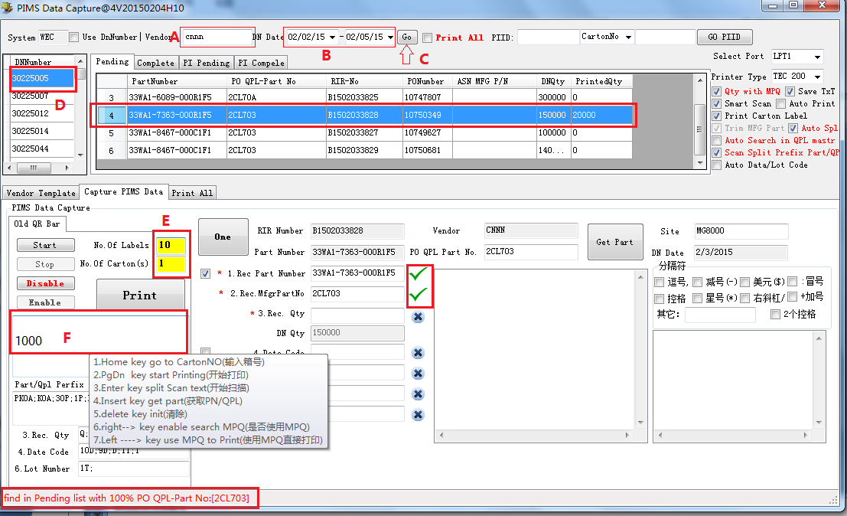
Scan Vendor
A: Enter Vendor ID B:Select the right Date Time C: click go
D: Select a Dn No E:Enter Num of Labels F: Scan Barcode

Slide 6
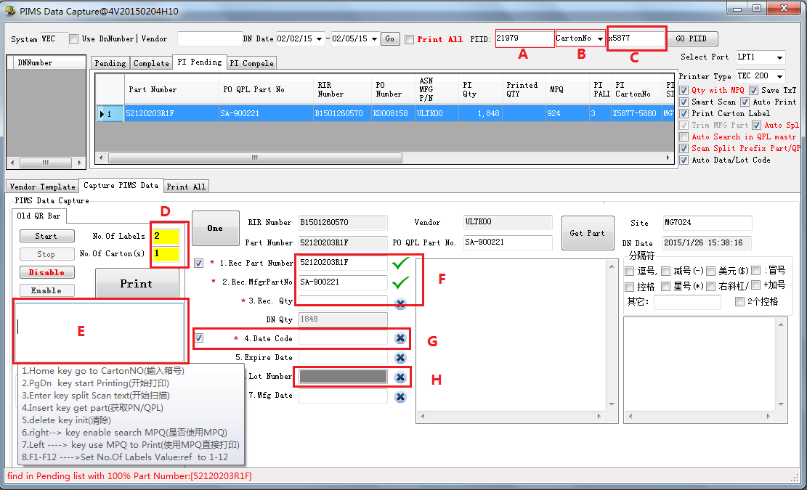
Scan PI
A: Enter PI ID B:Select the right Item C: if Carton No then Scan Box No
D:Enter Num of Labels E: Scan Barcode

Slide 7
--END--

